Slide 1
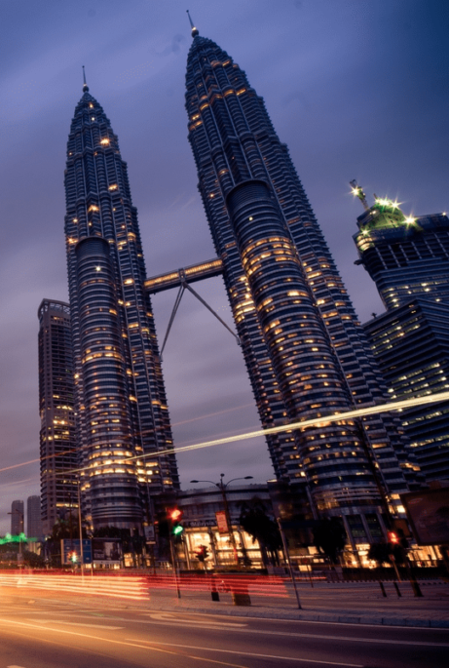
Lab Session 1C
STRENGTHENING FINANCIAL RESILIENCE FOR MALAYSIA’S SUSTAINABLE FUTURE
KEYNOTE ADDRESS AT THE 2025 MALAYSIA SUSTAINABLE FUTURE SUMMIT
by Liew Zhi Tong, Uithiswary a/p Velan, Priveeta Gobi Krishnan and Yeo Hui Yi | Ministry of Finance

Slide 2
WELCOME TO THE 2025 MALAYSIA SUSTAINABLE FUTURE SUMMIT
Malaysia’s governmental structure is built upon ministries that drive policies into actionable outcomes. Among the 20 ministries, the Ministry of Finance (MOF) plays a crucial role in managing the nation’s financial resources, economic policies, and fiscal sustainability. Established in 1957, MOF formulates and implements fiscal policies, manages taxation, oversees government procurement, and ensures sustainable economic growth.
This presentation will provide data-driven insights into Malaysia’s financial landscape, focusing on federal revenue, budget allocations, and development expenditures from 2010 to 2022. These insights will highlight their alignment with Sustainable Development Goals (SDGs) and strategies for economic resilience.
Through compelling visuals and strategic analysis, we will explore how fiscal policies, economic diversification, and public-private partnerships can foster long-term financial stability and drive sustainable national growth.
Lab Session 1C

Slide 3
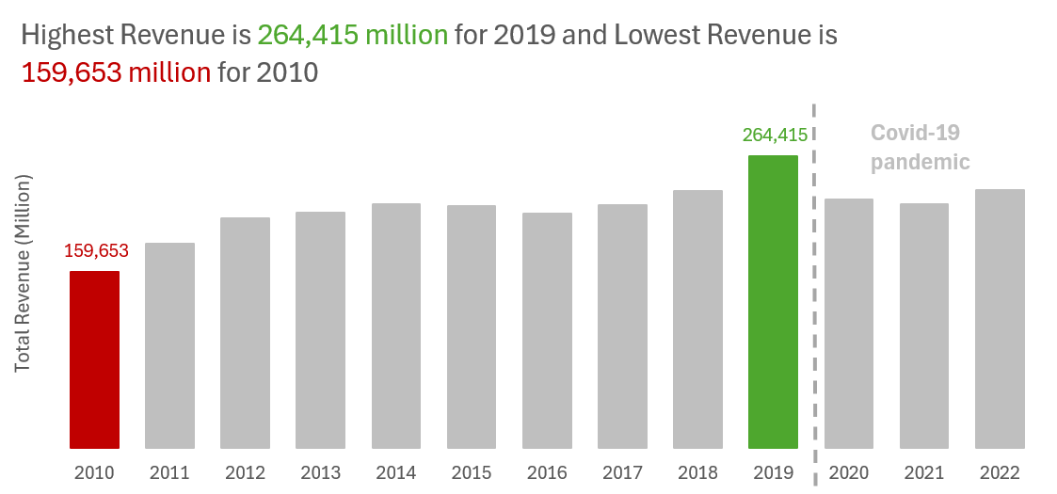
VISUAL 1 – GOVERNMENT REVENUE TRENDS (BAR CHART)
Visual
Bar chart showing government revenue from 2010–2022.
Key Highlights
Revenue fluctuations, especially the significant decline in 2020 due to COVID-19.
The need for diversified revenue sources to mitigate external shocks.
The proposal for a Revenue Stabilization Fund to maintain financial resilience.
Design Considerations
Red highlight for the lowest revenue year (2010).
Green highlight for the highest revenue year.
Remove gridlines for clarity.
Annotations explaining key events.
The data labels for highest and lowest matched the color of its bar for clarity.
The title is on the top right side.
Data source : https://ekonomi.gov.my/en/socio-economic-statistics/economic-statistics/public-sector
Lab Session 1C

Slide 4
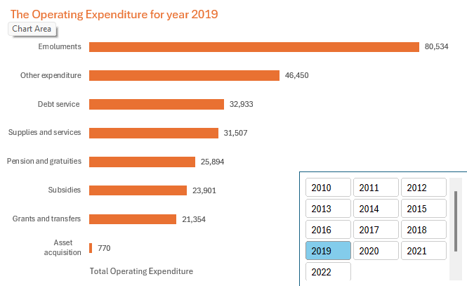
VISUAL 2 – BREAKDOWN OF EXPENDITURE (HORIZONTAL BAR CHART)
Visual
Horizontal bar chart showing major expenditure components in 2019, with a selectable filter to view data for other years from 2010 to 2022.
Key Highlights
High spending on salaries and debt payments limits financial flexibility.
More strategic resource allocation is needed for education, healthcare, and infrastructure.
Debt restructuring and performance-based pay systems can improve efficiency.
Design Considerations
Use a horizontal bar chart for clear category comparison.
Orange color for bars to maintain clarity.
Remove gridlines for a cleaner look.
Add a slicer to explore yearly trends.
Include data labels for precise values.
Data source : https://ekonomi.gov.my/en/socio-economic-statistics/economic-statistics/public-sector
Lab Session 1C

Slide 5
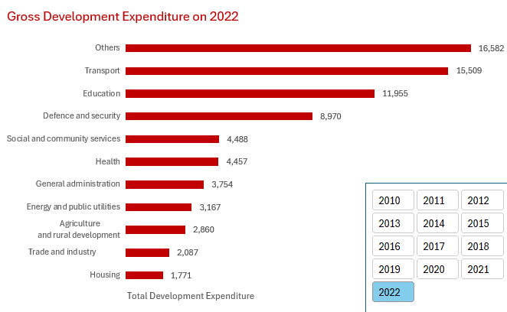
VISUAL 3 - DEVELOPMENT EXPENDITURE BREAKDOWN (HORIZONTAL BAR CHART)
Visual
Horizontal bar chart showing the distribution of development expenditure by category for the year 2022, with a selectable filter to view data for other years from 2010 to 2022.
Key Highlights
Education and transport receive the largest allocations, reflecting the government's focus on human capital and infrastructure development.
Healthcare, agriculture, and social programs receive comparatively lower funding, which may impact social well-being and economic resilience.
A reassessment of expenditure priorities is needed to ensure a balanced allocation that supports long-term economic stability and national development.
Design Considerations
Horizontal bar format for easy comparison across sectors.
Plain red color for bars to maintain clarity.
Add a slicer to explore yearly trends.
Data labels on each bar to ensure accurate interpretation of values.
Removal of gridlines and axis lines to reduce visual clutter.
Data source : https://ekonomi.gov.my/en/socio-economic-statistics/economic-statistics/public-sector
Lab Session 1C

Slide 6

ALIGNMENT WITH SDGS
SDG 4: Quality Education
Ensures inclusive, high-quality education and lifelong learning.
Supports economic and social progress through educational investments.
SDG 9: Industry, Innovation, and Infrastructure
Develops resilient infrastructure and promotes industrial growth.
Enhances trade, market access, and economic expansion through transport investments.
SDG 17: Partnerships for the Goals
Strengthens global partnerships for sustainable development.
Encourages collaboration to overcome financial constraints in development projects.
Lab Session 1C

Slide 7

GOVERNMENT INITIATIVES FOR SDGS
SDG 4 Initiatives
Invests in primary, secondary, and vocational education.
Enhances teacher training, curriculum updates, and rural education access.
SDG 9 Initiatives
Funds renewable energy projects and smart urban centers.
Supports R&D for innovation and industrial productivity growth.
SDG 17 Initiatives
Forms Public-Private Partnerships (PPPs) for infrastructure and social programs.
Collaborates with private sector, international organizations, and civil society for resource mobilization.
Lab Session 1C

Slide 8
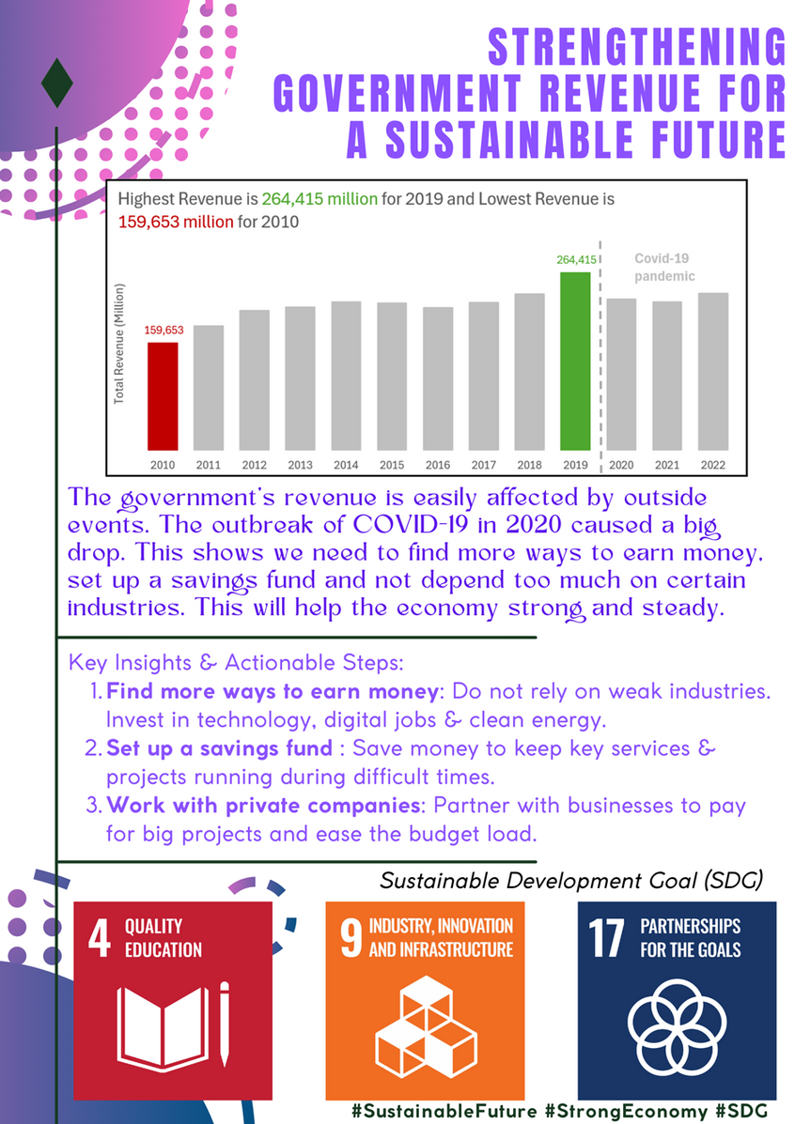
POSTER
Lab Session 1C

Slide 9

CONCLUSION
This analysis highlights the government's financial priorities, revealing challenges in balancing operating and development expenditures. Revenue trends show vulnerabilities to external shocks, emphasizing the need for economic diversification and stabilization measures. While budget allocation prioritizes education and infrastructure, underfunding in healthcare and agriculture requires policy adjustments. Aligning fiscal strategies with SDG 4, SDG 9, and SDG 17 is crucial for sustainable national growth. Implementing strategic reforms, optimizing costs, and leveraging public-private partnerships can enhance financial efficiency and long-term economic resilience.
Lab Session 1C

Slide 10

Lab Session 1C
THANK YOU

